Slide 1
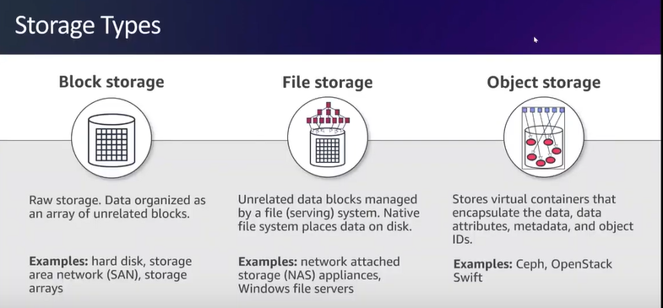

Slide 2
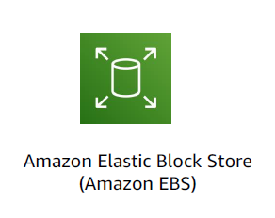
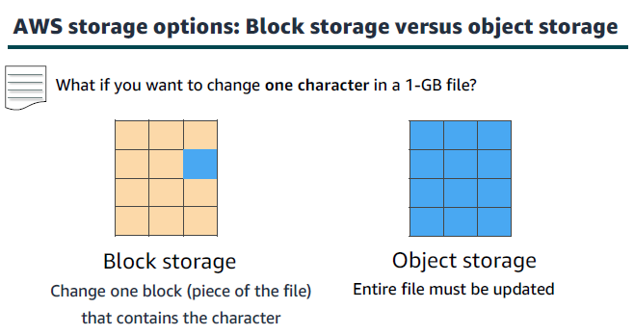

Slide 3
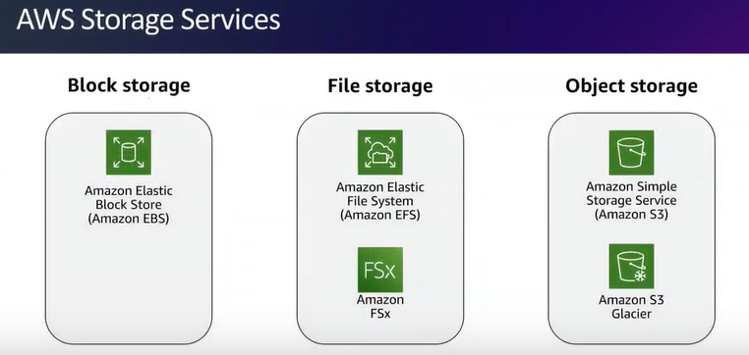

Slide 4
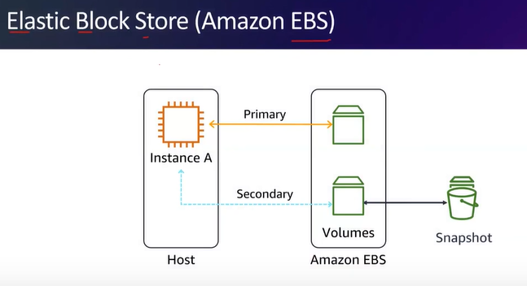

Slide 5


Slide 6
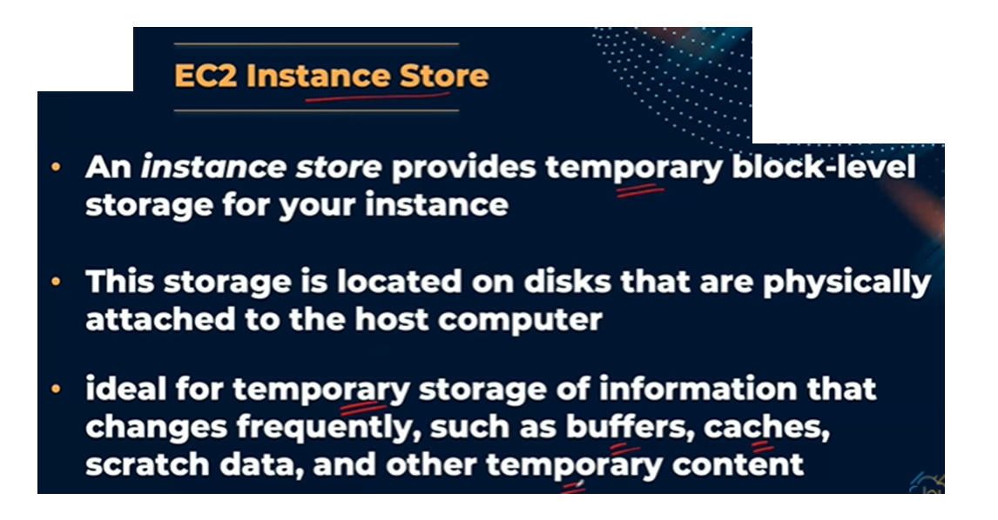

Slide 7
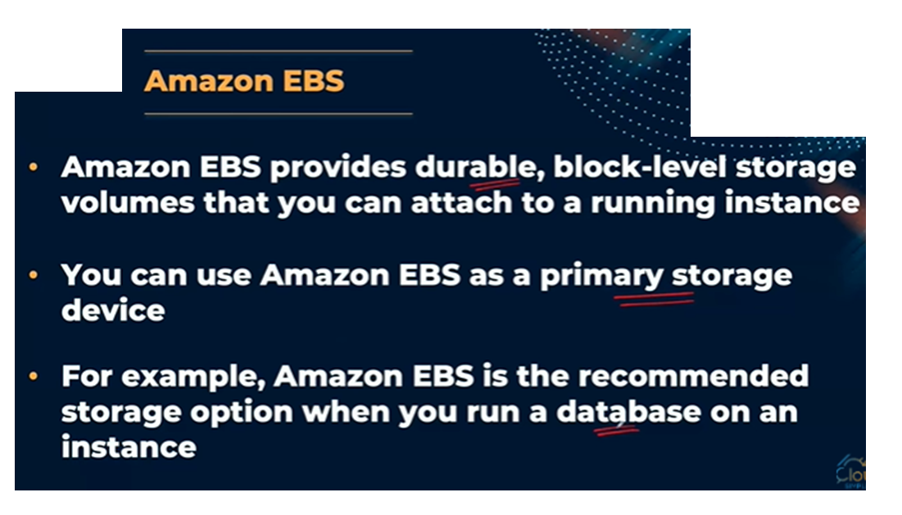

Slide 8


Slide 9
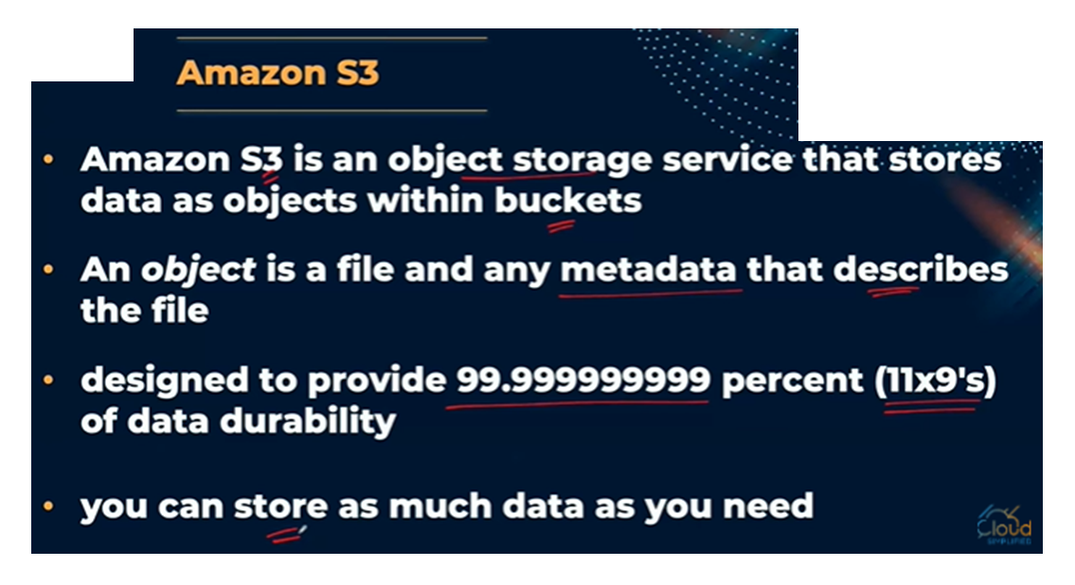

Slide 10
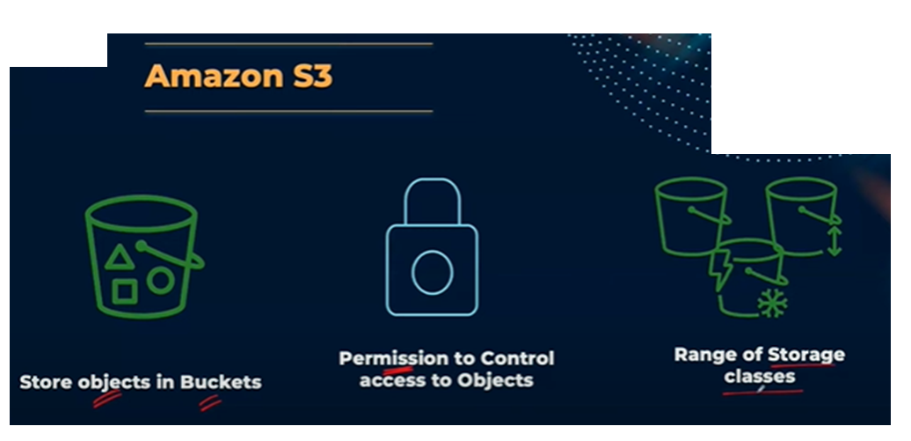

Slide 11


Slide 12
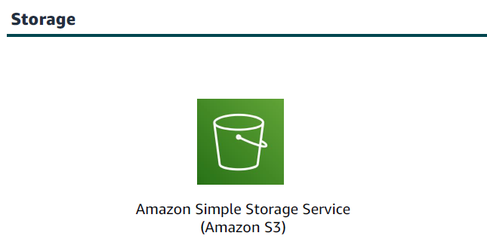
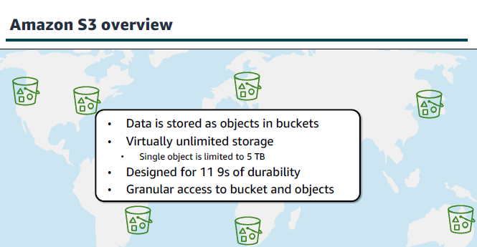

Slide 13
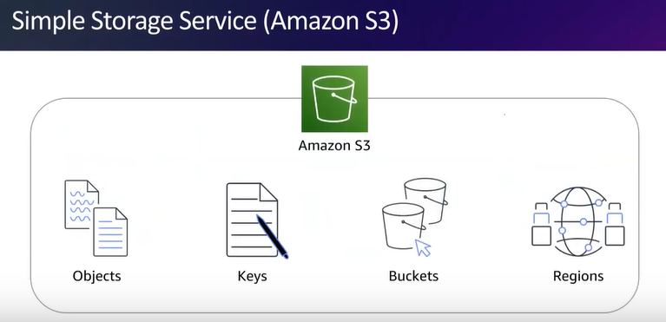

Slide 14
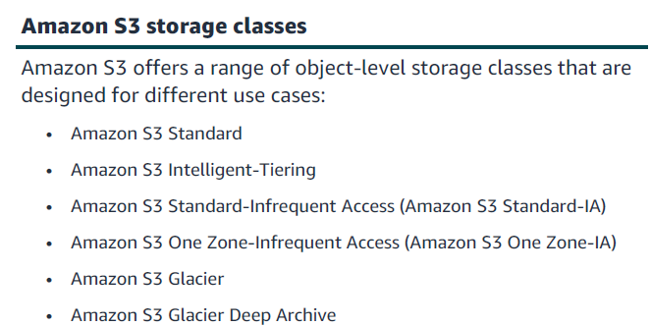

Slide 15
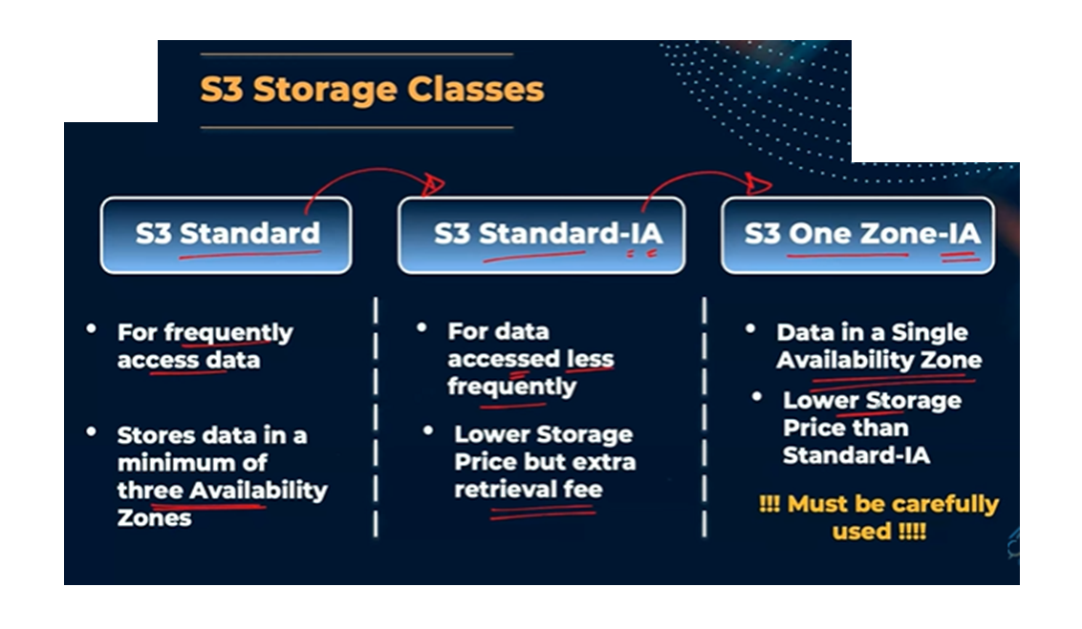

Slide 16
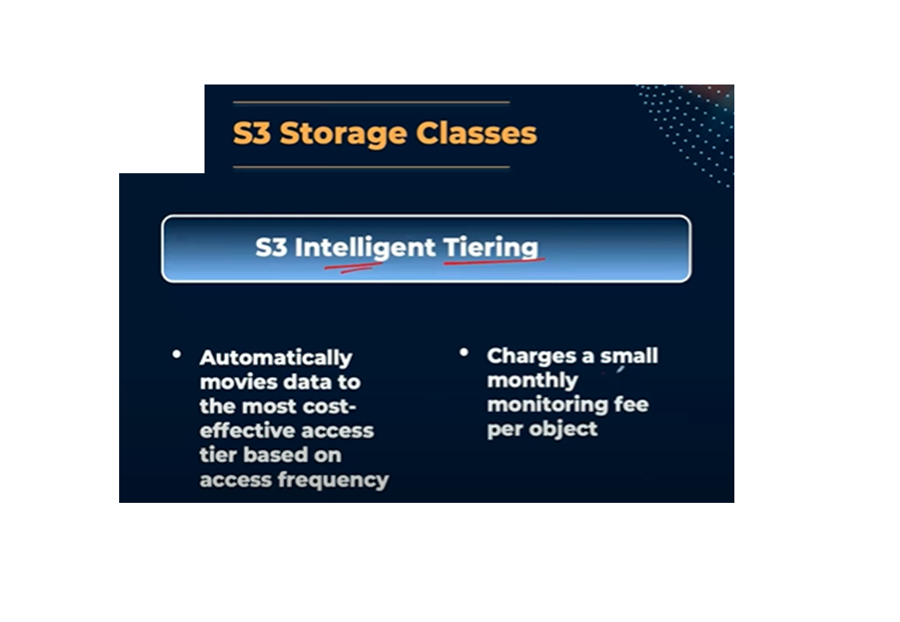

Slide 17
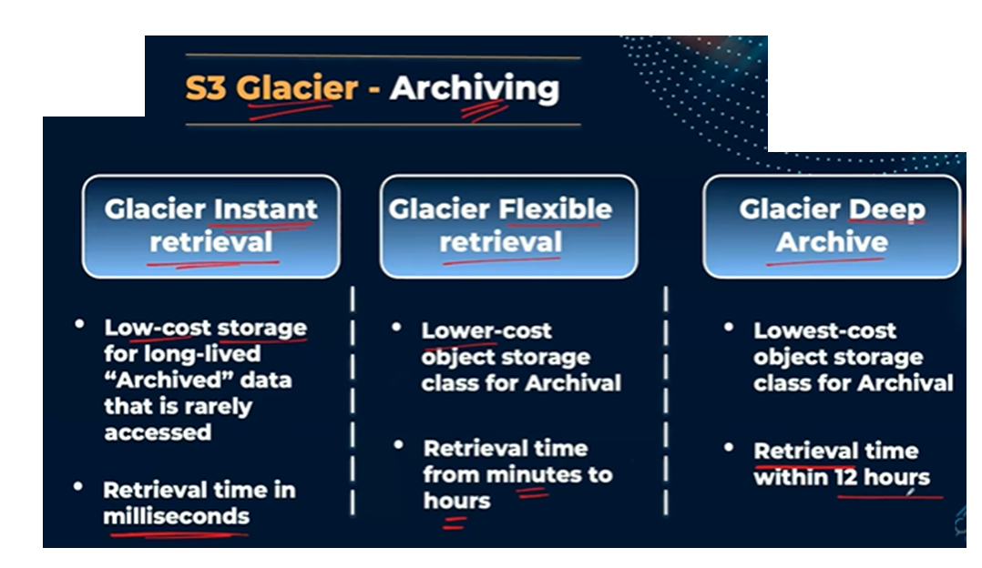

Slide 18
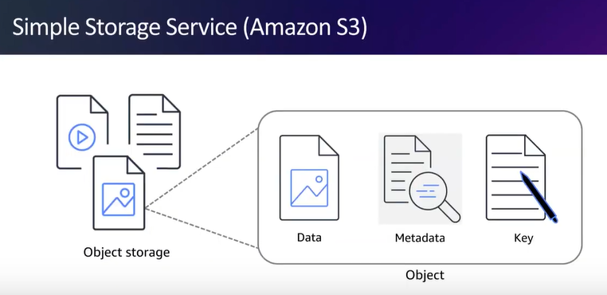

Slide 19
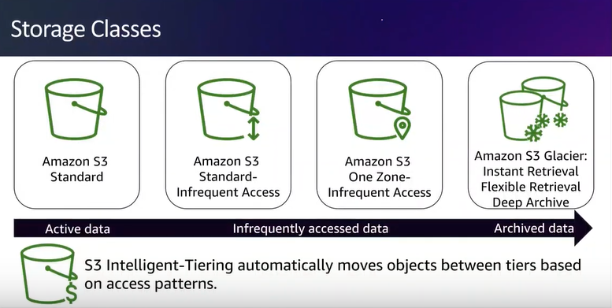

Slide 20
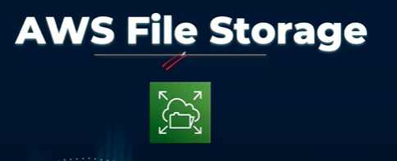
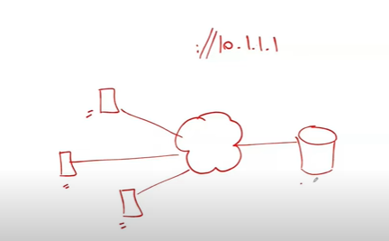

Slide 21
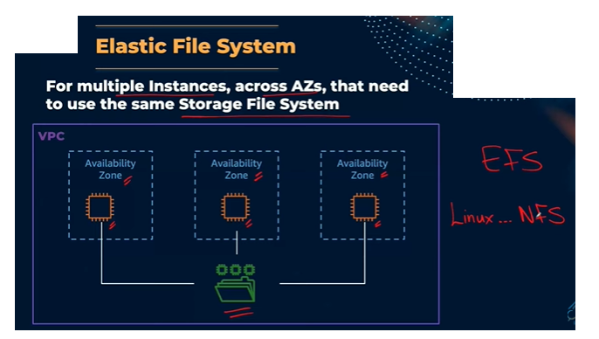

Slide 22
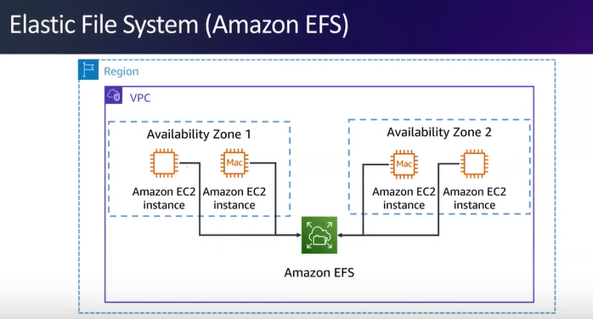

Slide 23
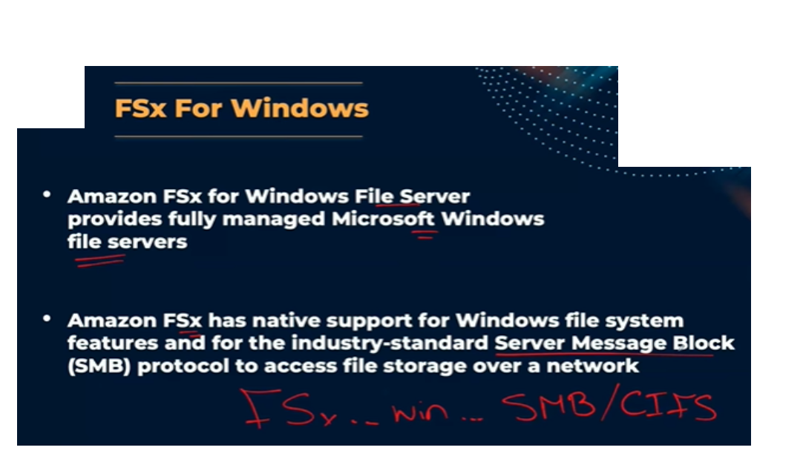

Slide 24
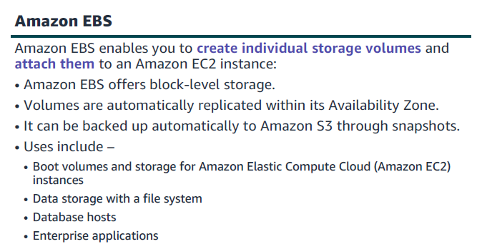

Slide 25
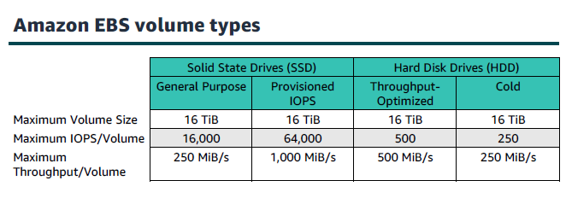

Slide 26
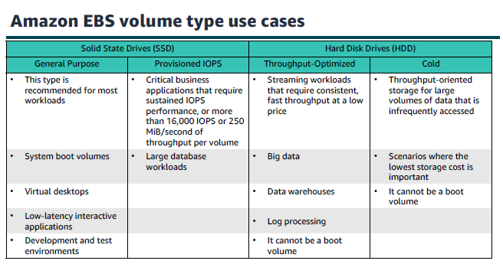

Slide 27
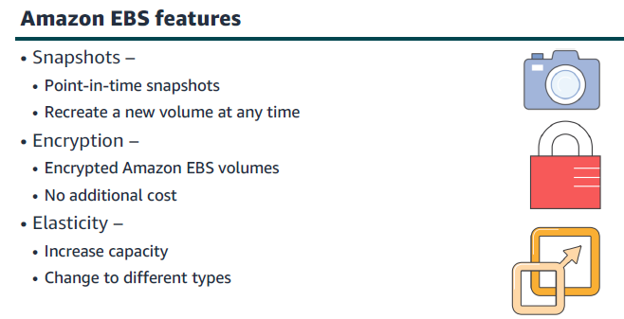

Slide 28
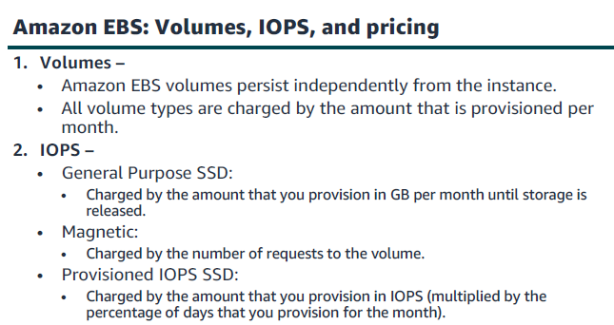

Slide 29
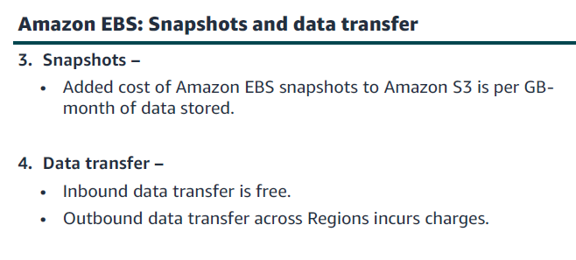

Slide 30
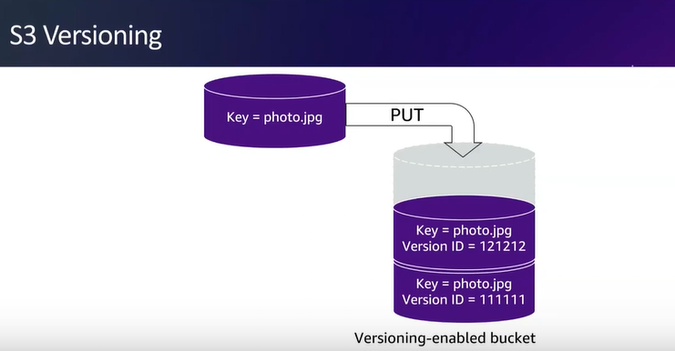

Slide 31
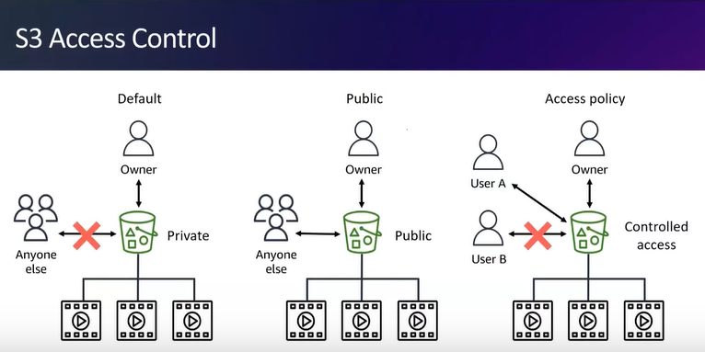

Slide 32
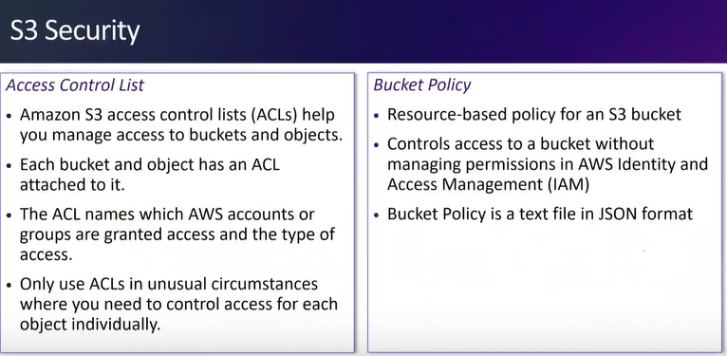

Slide 33
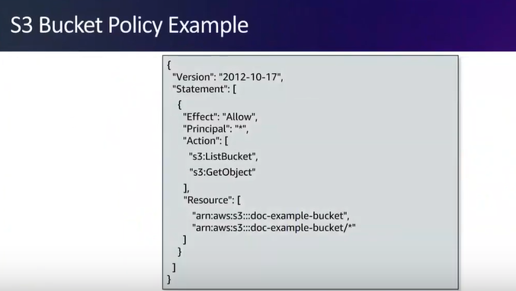

Slide 34
LAB

Slide 35
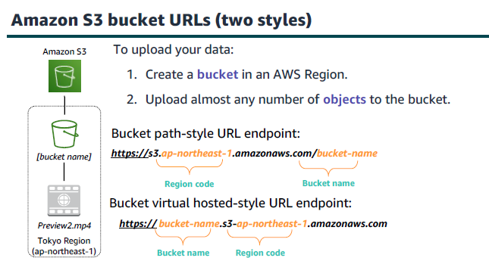

Slide 36
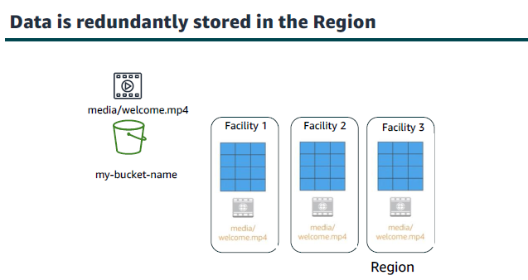

Slide 37
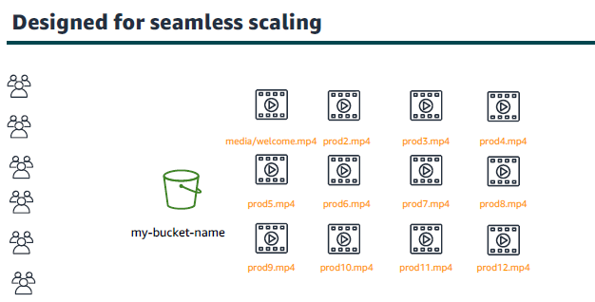

Slide 38
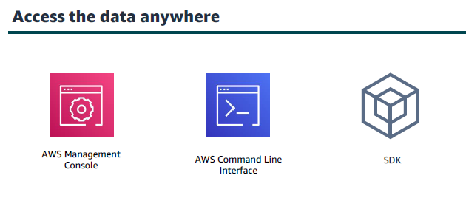

Slide 39
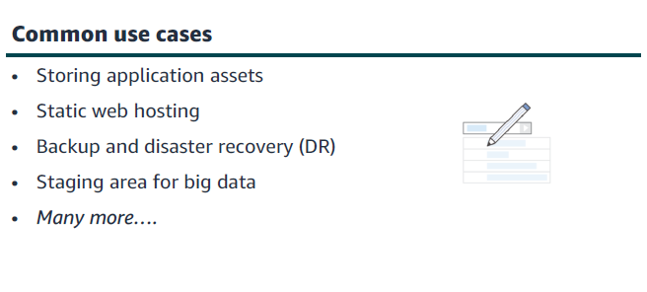

Slide 40
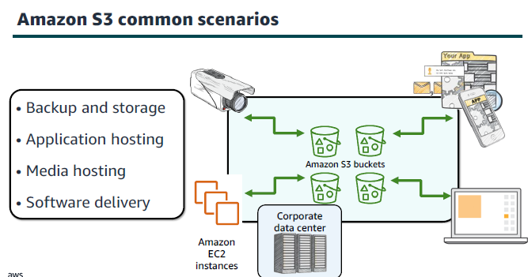

Slide 41
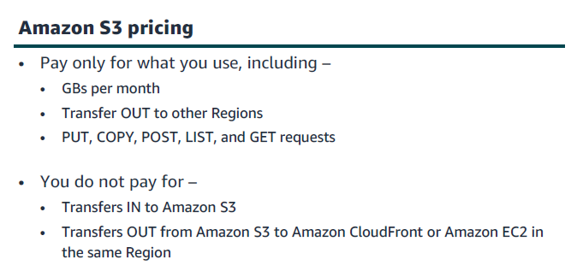

Slide 42
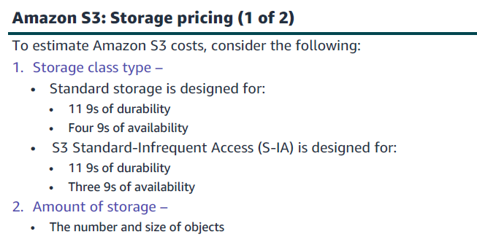

Slide 43
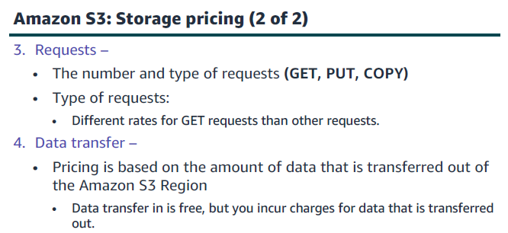

Slide 44
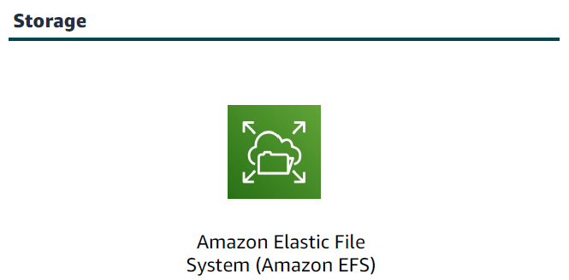
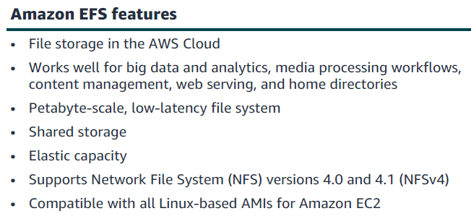

Slide 45
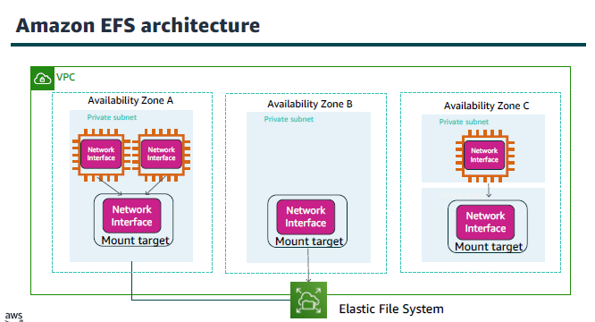

Slide 46
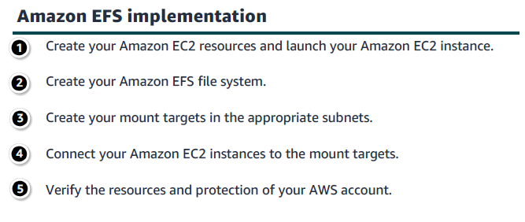

Slide 47
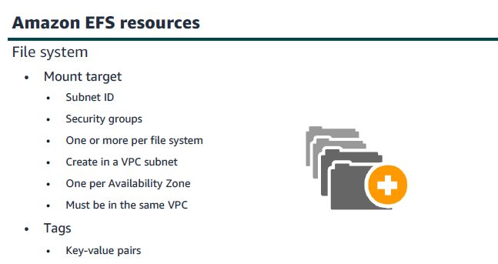

Slide 48
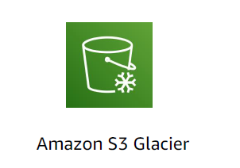
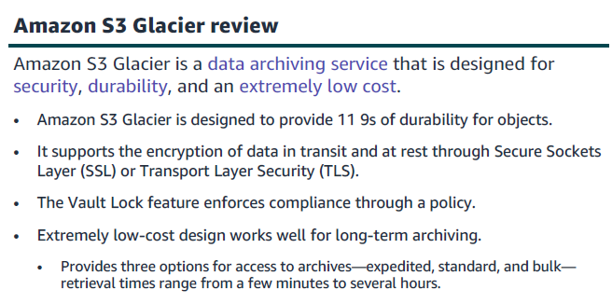

Slide 49
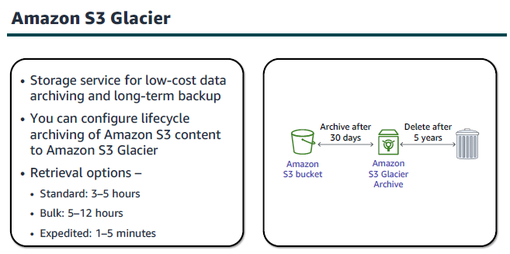

Slide 50


Slide 51


Slide 52


Slide 53


Slide 54


Slide 55


Slide 56


Slide 57


Slide 58


Slide 59

Elastic Block Store (EBS)
EBS is a network drive you can attach to your instances
An EBS can only be mounted to one instance at a time
An EBS is bound to a specific Availability Zone
It can be detached from an EC2 instance and attached to another one quickly

Slide 60
Elastic Block Store (EBS)
It’s locked to an Availability Zone (AZ)
An EBS Volume in an AZ cannot be attached to another AZ
To move a volume across AZs, you first need to snapshot it
You can control the EBS behavior when an EC2 instance is terminated
By default, the root EBS volume is deleted
By default, any other attached EBS volume is not deleted

Slide 61

EBS Snapshots
Make a backup (snapshot) of your EBS volume at a point in time
You can copy snapshots across AZs or Regions

Slide 62

Lab Overview

Slide 63

Search for EC2

Slide 64

An EC2 instance named Lab has already been launched

Slide 65

The instance is attached to “us-east-1a” AZ

Slide 66

Create a new Volume

Slide 67

Choose the volume type, size, and AZ
(Same as EC2 AZ)

Slide 68

Add a tag “Name” and create the instance

Slide 69

Wait for the new volume to be available

Slide 70

Attach the created volume to the EC2

Slide 71

Select the instance

Slide 72

Configure the device name and attach the volume

Slide 73

Connect to the EC2 instance

Slide 74

Connect to the EC2 instance

Slide 75

Connected

Slide 76

View the storage available on your instance

Slide 77

Create an ext3 file system on the new volume (/dev/sdf)

Slide 78

Create a directory for mounting the new storage volume

Slide 79

Mount the new volume

Slide 80

Configure the Linux instance to mount this volume whenever the instance is started

Slide 81

View the available storage

Slide 82

The new volume (/dev/xvdf) is mounted

Slide 83

Create a txt file with some text on the new volume

Slide 84

Check the created file

Slide 85

Create a snapshot from the volume

Slide 86

Create snapshot

Slide 87

Remove the created file

Slide 88

List the content of the directory, the created file (file.txt) has been deleted

Slide 89

Create a new volume from the created snapshot

Slide 90

Configure the volume type, size, and AZ

Slide 91

Create the volume

Slide 92

Attach the new volume to the EC2

Slide 93

Select the EC2

Slide 94

Configure the device name and attach the volume

Slide 95

Create a directory for the new volume

Slide 96

Mount the new volume

Slide 97

List the content of the directory of the new volume, you should be able to see the file (file.txt)

Slide 98





Case Studies
Case 1: A data analytics company for travel sites must store billions of customer events per day. They use the data analytics services that are in the diagram. The following diagram illustrates their architecture.
Amazon API Gateway
Amazon Kinesis
AWS Lambda
Amazon Kinesis Data Firehose
Amazon Elastic Container Service
Amazon Kinesis
Storage ??
Notes:
Amazon S3: Firehoses transform the data, process it, and send it to a s3 bucket

Slide 99



Case Studies
Case 2: A collaboration software company processes email for enterprise customers. They have more than 250 enterprise customers and more than half a million users. They must store petabytes of data for their customers. The following diagram illustrates their architecture.
Elastic Load Balancing
Corporate data center
Storage ??
Amazon EC2 instances
Notes:
Amazon EFS: Petabyte Scale, and low latency file sytem

Slide 100



Case Studies
Case 3: A data protection company must be able to ingest and store large amounts of customer data and help their customers meet compliance requirements. They use Amazon EC2 for scalable compute and Amazon DynamoDB for duplicate data and metadata lookups. The following diagram illustrates their architecture.
Amazon EC2
Amazon DynamoDB
Clients
Storage ??
Notes:
Amazon EBS

Slide 101
Questions
1- What is an EBS Snapshot?
An operation system on an EC2 instance
A backup of your EBS volume at a point in time
The amount of CPU and RAM of an EC2 instance
A screenshot of your EC2 instance
Notes:
B. A backup of your EBS volume at a point in time

Slide 102
Questions
2- What is an EBS Volume tied to?
A Region
A Data center
An Edge Location
An Availability Zone
Notes:
D. An Availability Zone

Slide 103
Questions
3- Which statement is CORRECT regarding EBS?
An EBS can be mounted to multiple instances at a time
An EBS can be used in a regional scale
You can control the EBS behavior when an EC2 instance is terminated
You cannot copy snapshots across Regions
Notes:
C. You can control the EBS behavior when an EC2 instance is terminated

Slide 104
Questions
4- EBS Volumes CANNOT be attached to multiple EC2 instances at a time.
True
False
Notes:
A. True

Slide 105
Questions
5- An EBS Volume is a network drive you can attach to your instances while they run, so your instances' data persist even after their termination.
True
False
Notes:
A. True

Slide 106
Questions
6- An EBS is limited to an AZ, there is no way to move the volume across AZs.
True
False
Notes:
B. False

Slide 107
Thank You

Slide 108

Notes:
true

Slide 109

Notes:
S3 replicates all objects in multiple availability zones within the same region.

Slide 110

Notes:
Glacier, S3 Infrequent Access and S3 StandardAccess can be used as a storage class for an S3object lifecycle policy.

Slide 111

Notes:
The name of an S3 bucket must be uniqueworldwide across all AWS accounts.

Slide 112

Notes:
You can use EFS to implement storage for EC2instances that multiple virtual machines canaccess at the same time.

Slide 113

Notes:
Amazon EBS is recommended when data must bequickly accessible, requiring long-termpersistence and requires an encryption solution.

Slide 114

Notes:
false

Slide 115

Notes:
The vault in Amazon Glacier is a container forstoring archives.

Slide 116

Notes:
true

Slide 117

Notes:
Amazon EBS volumes persist when the instance isstopped. The data is automatically replicated within anAvailability Zone, can be encrypted upon creation andused by an instance, as if they were not encrypted.

